Slide 1

Box Car Races
July 19, 2025 @1000

Slide 2
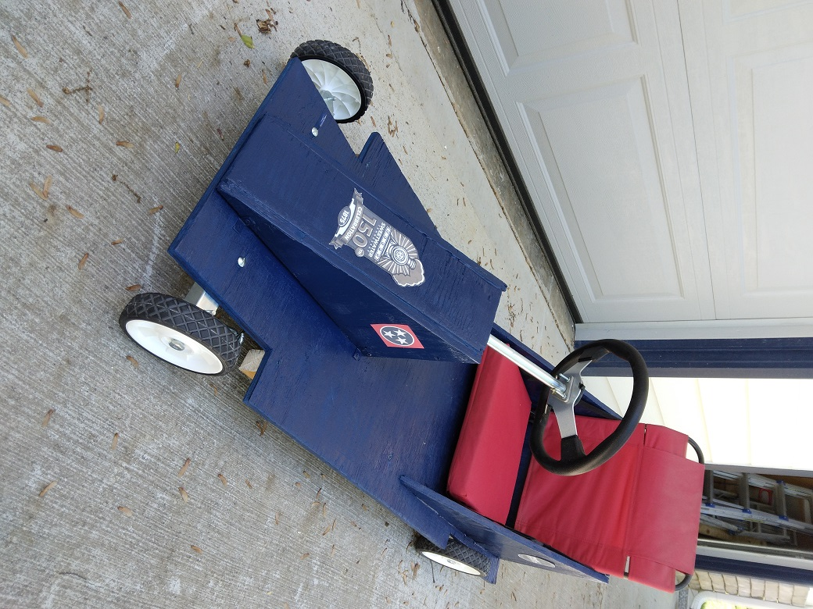
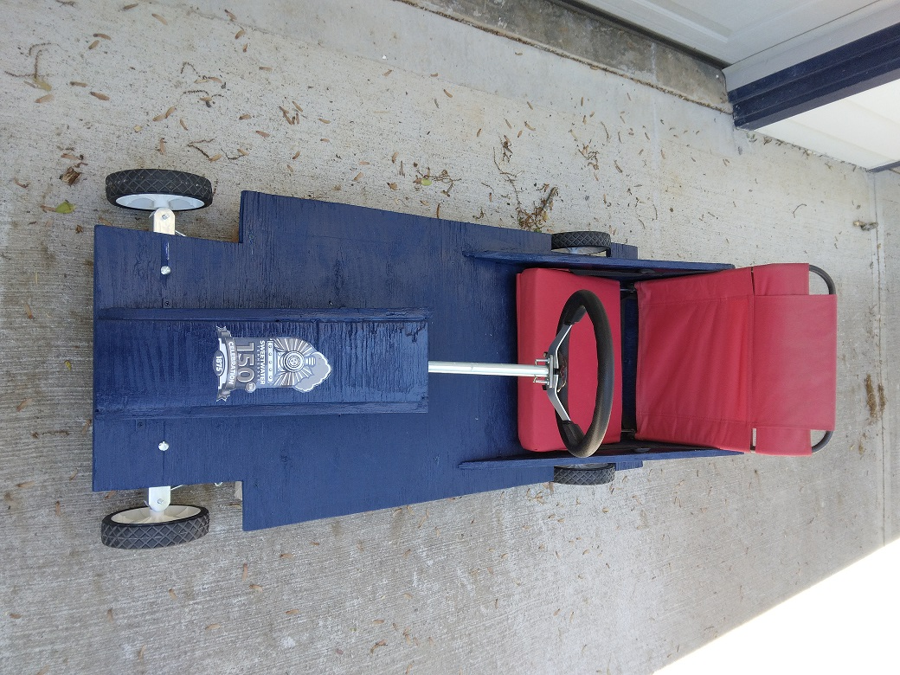
Box Car Races

Slide 3
Box Car Races
Saturday 7/19/25 @1000 At the Sweetwater City Recreational Park (off Starrett St)
Cars will be available, children between the ages of 6-12 are eligible.
Sign-up and complete waiver form.

Slide 4
Box Car Races
We will have Sweetwater Creamery selling ice cream.
Boy Scouts will be selling burgers & dogs and soda & water

Slide 5
In Closing
Participate or come cheer on your favorite.
It should be a fun time.
Send any questions you may have to: jfcbkc1@gmail.com

